Slide 1
Angular 7 FEATURES

Slide 2
Objectives:
Features of Angular7
Components
Modules
Data Binding
Event Binding
Directives
Pipes
Animations
Material

Slide 3
What is Angular 7?
AngularJS is a structural framework for dynamic web apps. It lets you use HTML as your template language and lets you extend HTML's syntax to express your application's components clearly succinctly. AngularJS's data binding and dependency injection eliminate much of the code you would otherwise have to write.
Prerequisites of Angular 7:
Angular 2
Typescript
HTML
CSS

Slide 4
Component :
Components are like the basic building block in an angular application.
Each modules consists of one or more components, if only one component that means known as ROOT component
A component has a selector , template , style and other properties, using which it specifies the metadata required to process the component.
The file structure has the app component and it consists of the following files :
app.component.css
app.component.html
app.component.spec.ts
app.component.ts

Slide 5
Modules:
Module in Angular refers to a place where you can group the components, directives, pipes, and services, which are related to the application.
To define module, we can use the NgModule. When you create a new project using the Angular –cli command, the ngmodule is created in the ap.module.ts file by default.
The NgModule needs to be imported as follows:
import { NgModule } from '@angular/core';

Slide 6
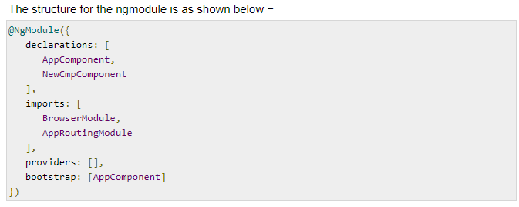

Slide 7
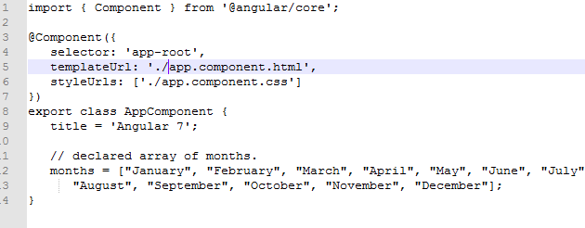
Data Binding:
It pass data from .html to .ts file OR pass data from .ts file to .html vice versa
We use curly braces for data binding - {{}}; this process is called interpolation.
Let us now create a dropdown of months in the browser. To do that, we have created an array of months in app.component.ts as follows

Slide 8
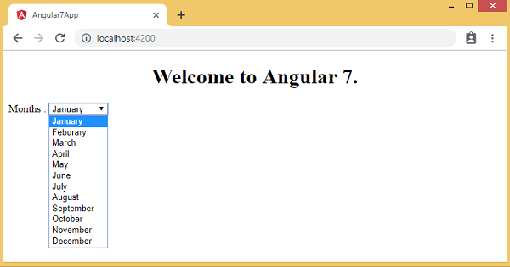
Following is the output of the above month’s array in the browser

Slide 9
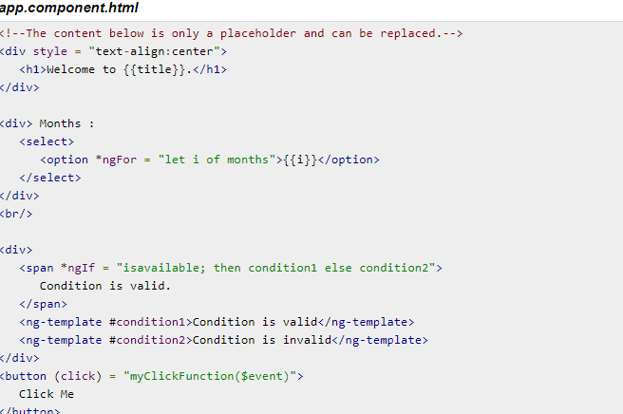
Event Binding:
When a user interacts with an application in the form of a keyboard movement, a mouse click, or a mouse over, it generates an event. These events need to be handled to perform some kind of action.
Let us consider an example to understand this better.

Slide 10
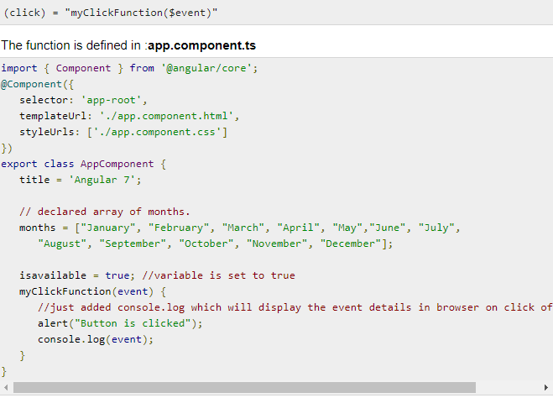

Slide 11
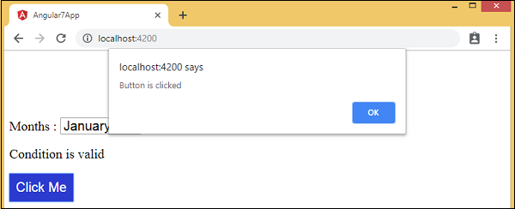
Upon clicking the button, the control will come to the function myClickFunction and a dialog box will appear, which displays the Button is clicked as shown in the following screenshot

Slide 12
Directives:
Directives in Angular is a js class, which is declared as @directive.
We have 3 directives in Angular.
Component Directive
Structural Directive
Attribute Directive

Slide 13
Component Directives:
These form the main class having details of how the component should be processed, instantiated and used at runtime.
Structural Directives:
A structure directive basically deals with manipulating the Dom elements. Structural directives have a * sign before the directive. For example, *ngIf and *ngFor.
Attribute Directives:
Attribute directives deal with changing the look and behaviour of the dom element.

Slide 14
Pipes:
Pipes were earlier called filters in Angular1 and called pipes from Angular2 onwards.
The | character is used to transform data. Following is the syntax for the same −

Slide 15
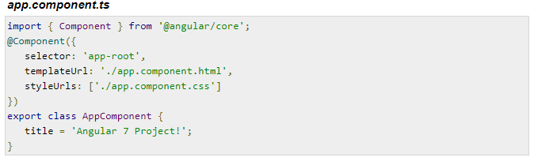
In the app.component.ts file, we have defined the title variable as follows −

Slide 16
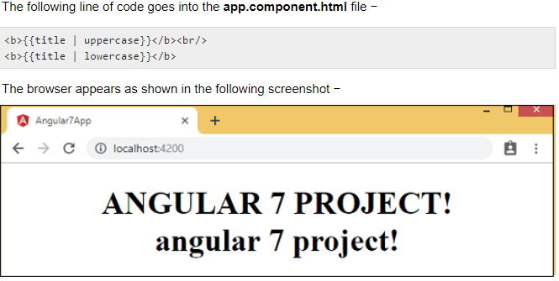
The following line of code goes into the app.component.html file −

Slide 17
Animations:
Animations add a lot of interaction between the html elements. Animation was available with Angular 2, from Angular 4 onwards animation is no more a part of the @angular/core library, but is a separate package that needs to be imported in app.module.ts.
To start with, we need to import the library with the below line of code −

Slide 18
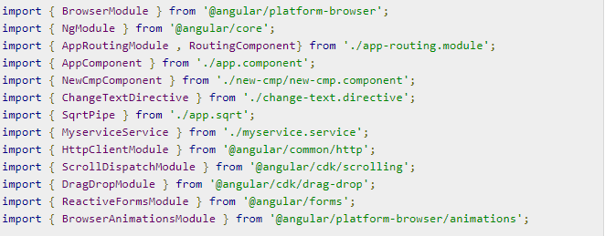
The BrowserAnimationsModule needs to be added to the import array in app.module.ts as shown below −

Slide 19
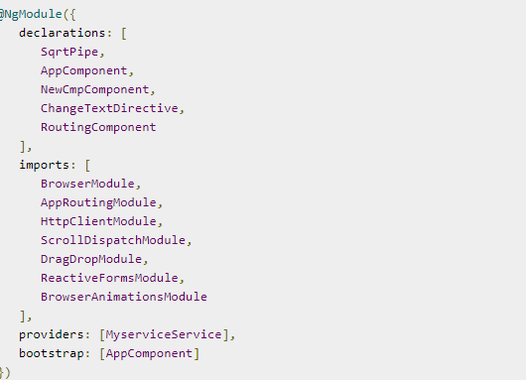

Slide 20
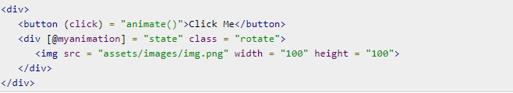
In app.component.html, we have added the html elements, which are to be animated.−
Let us now see the app.component.ts where the animation is defined.

Slide 21
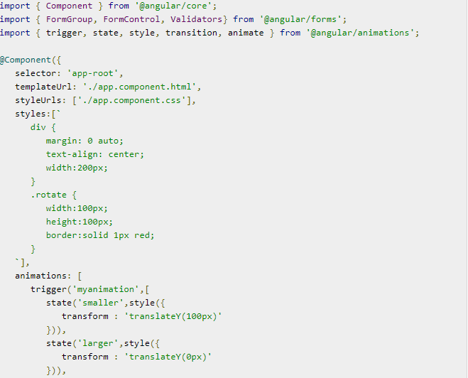

Slide 22
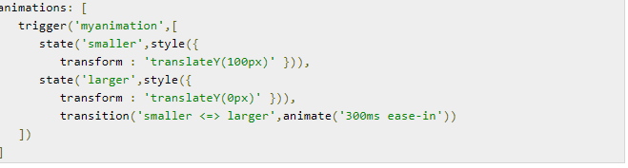
We have to import the animation function that is to be used in the .ts file as shown above.
Here we have imported trigger, state, style, transition, and animate from @angular/animations.
Now, we will add the animations property to the @Component () decorator −

Slide 23
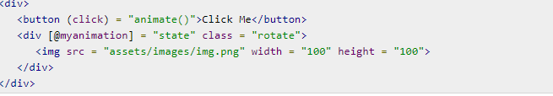
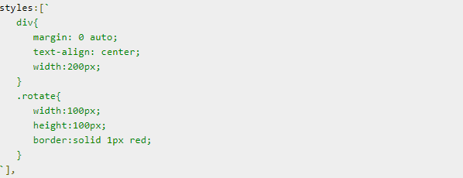
Let us now see the .html file to see how the transition function works −
There is a style property added in the @component directive, which centrally aligns the div. Let us consider the following example to understand the same −

Slide 24
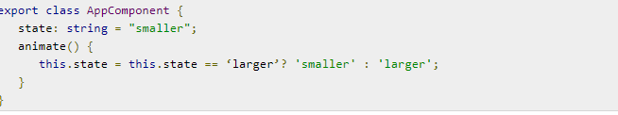
On the click of a button it calls the animate function, which is defined in the app.component.ts file as follows −

Slide 25
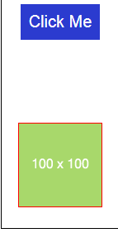
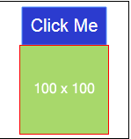
This is how the output in the browser (http://localhost:4200/) will look like −
Upon clicking the Click Me button, the position of the image is changed as shown in the following screenshot −

Slide 26
Material:
Materials offer a lot of built-in modules for your project. Features such as autocomplete, datepicker, slider, menus, grids, and toolbar are available for use with materials in Angular 7.
To start using materials, you need to install two packages: materials and cdk
Material components depend on the animation module for advanced features.
Hence you need the animation package for the same, @angular/animations.
Following is the command to add materials to your project −

Slide 27
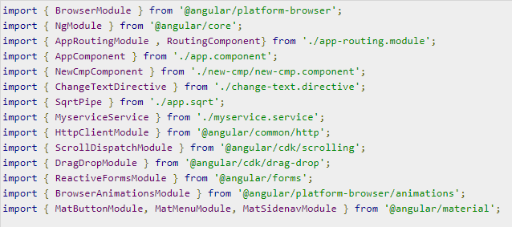
We will now import the modules in the parent module - app.module.ts as shown below.

Slide 28
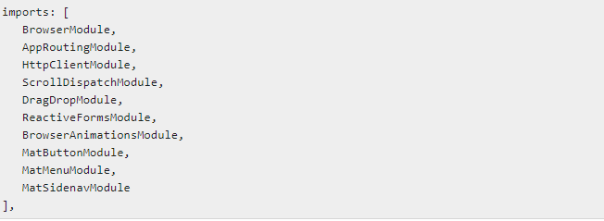
In the above file, we have imported the following modules from @angular/materials.
And the same is used in the imports array as shown below −

Slide 29
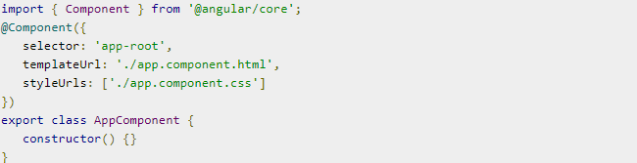
The app.component.ts is as shown below −
Let us now add the material-css support in styles.css
To add menu, <mat-menu></mat-menu> is used. The file and Save As items are added to the button under mat-menu. There is a main button added Menu. The reference of the same is given the <mat-menu> by using [matMenuTriggerFor]="menu" and using the menu with # in<mat-menu>.

Slide 30

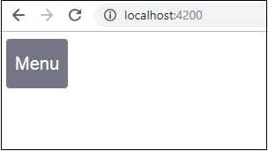
The below Image is displayed in the browser −

